Slide 1
jQuery Tutorial
Copyright Ellis Horowitz 2012-2016

Slide 2

What is jQuery?
A framework for client-side JavaScript.
Frameworks provide useful alternatives for common programming tasks.
An open source project at jquery.com
It simplifies
  HTML document traversing
  Event Handling
  Animating
  AJAX interactions
Copyright Ellis Horowitz 2012-2016

Slide 3
What is available with jQuery?
Cross browser support and detection
AJAX functions
CSS functions
DOM manipulation
DOM transversal
Attribute manipulation
Event detection and handling
JavaScript animation
Hundreds of plugins for pre-built user interfaces, advanced animations, form validation, etc
Expandable functionality using custom plugins
Small foot print
Copyright Ellis Horowitz 2012-2016

Slide 4
Downloading jQuery
Installation – You just download the latest jquery-x.y.z.js file and put it in your website folder
http://jquery.com/download
jQuery is lightweight: 30KB (Minified and Gzipped)‏
Copyright Ellis Horowitz 2012-2016

Slide 5
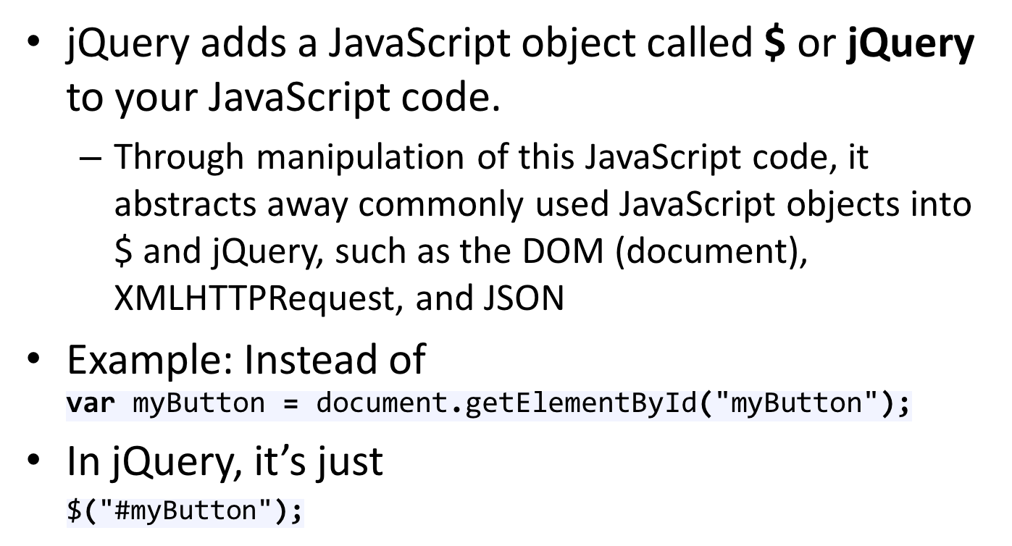
So How Does jQuery Change How You Write JavaScript?
Copyright Ellis Horowitz 2012-2016

Slide 6
jQuery Basic Selectors
These are examples of “Basic” selectors, based on CSS1:
All Selector (“*”): selects all elements, sets css properties and returns the number of elements found
var elementCount = $("*").css("border", "3px solid red" ).length;
Class Selector (“.class”): selects all elements with a given class and sets css properties
$(".myClass").css("border", "3px solid red");
Element selector (“element”): selects all elements with the given tag name, e.g. div, and sets css properties
$("div").css("border", "9px solid red");
ID selector (“#id”): selects a single element with the given id attribute
$("#myDiv").css("border", "3px solid red");
Multiple selector (“selector1, selector2, selectorN"): selects a combined result of all the specified selectors
$("div, span, p.myClass").css("border", "3px solid red");
For more examples see: http://api.jquery.com/category/selectors/basic-css-selectors/
Copyright Ellis Horowitz 2012-2016

Slide 7
Other jQuery Selector Categories
JQuery borrows notation from CSS1-3 “selectors”, as a tool to match a set of elements. Here are some examples of what one can do:
Attribute: selects elements that have the specified attribute and changes the associated text
$("input[value='Hot Fuzz'] "). text( "Hot Fuzz" ) ;
Basic Filter, e.g. selects all elements that are h1, h2, h3, etc and assigns css properties
$(":header").css({ background: "#ccc", color: "blue" });
Child Filter, e.g. finds the first span in each div and underlines the text
$("div span:first-child").css( "text-decoration", "underline" )
Content Filter, e.g. finds all div containing “John” and underlines them
$("div:contains('John’)").css( "text-decoration", "underline" );
Form, e.g. finds all buttons and adds the css class “marked” to their properties
var input = $(":button").addClass( "marked" );
For more examples see: http://api.jquery.com/category/selectors
Copyright Ellis Horowitz 2012-2016

Slide 8
jQuery Functions
Either attached to the jQuery object or chained off of a selector statement.
  E.g. Run a function when the page is fully loaded
$( window ).load(function()this function created is anonymous {
//run code //anonymous function definition
} );
Most functions return the jQuery object they were originally passed, so you can perform many actions in a single line.
  E.g. Add the class bigImg to all images with height > 100 once the image is loaded search for image with class name userIcon
  $("img.userIcon" ).load(function() {
  if ( $( this ).height() > 100 {
  $( this ).addClass("bigImg");
  }
  });
The same function can perform an entirely different action based on the number and type of parameters.
Copyright Ellis Horowitz 2012-2016

Slide 9
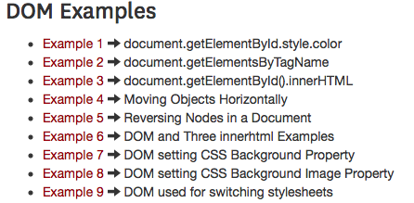
More jQuery Examples
Remember these examples?
http://cs-server.usc.edu:45678/examples.html#dom
We’ll revisit the examples, but with jQuery instead!
Copyright Ellis Horowitz 2012-2016

Slide 10

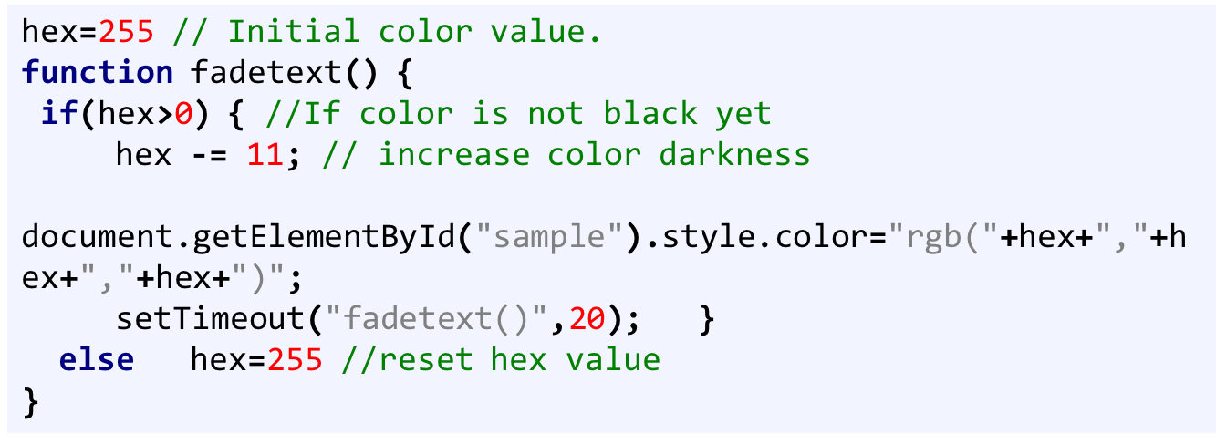
Example 1: document.getElementById.style.color
JavaScript w/o jQuery
http://cs-server.usc.edu:45678/examples/dom/ex1.html
Copyright Ellis Horowitz 2012-2016

Slide 11
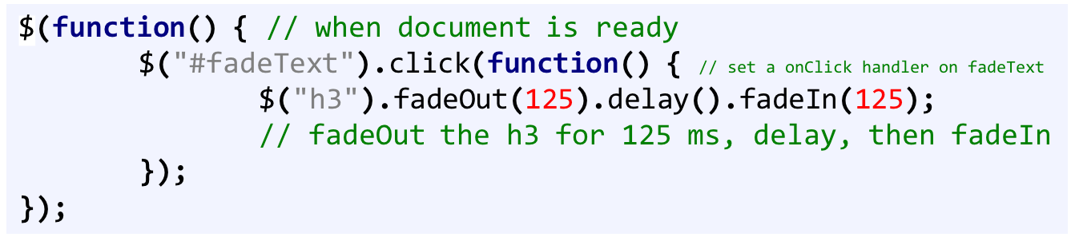
Example 1: $.fadeOut(), $.delay(), $.fadeIn()
JavaScript with jQuery
http://cs-server.usc.edu:45678/examples/jquery/dom/ex1.html
Copyright Ellis Horowitz 2012-2016

Slide 12
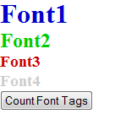
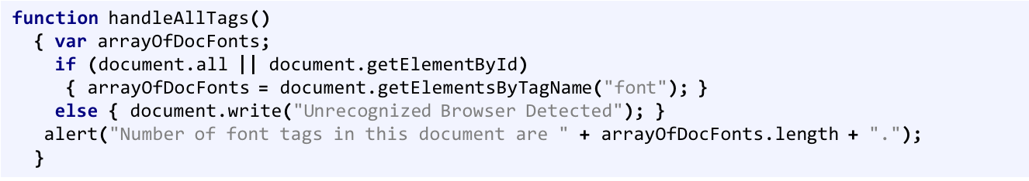
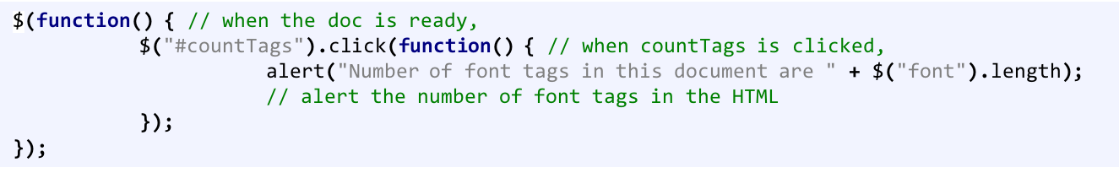
Example 2: document.getElementsByTagName
JavaScript w/o jQuery
JavaScript w/ jQuery
http://cs-server.usc.edu:45678/examples/dom/ex2.html
http://cs-server.usc.edu:45678/examples/jquery/dom/ex2.html
Copyright Ellis Horowitz 2012-2016

Slide 13

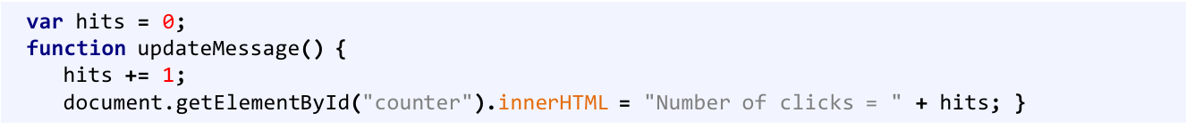
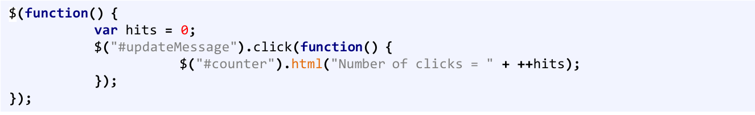
Example 3: document.getElementById().innerHTML
JavaScript w/o jQuery
JavaScript w/ jQuery we don’t need to use innerhtml in jquery. Rather use html function only
http://cs-server.usc.edu:45678/examples/dom/ex3.html
http://cs-server.usc.edu:45678/examples/jquery/dom/ex3.html
Copyright Ellis Horowitz 2012-2016

Slide 14
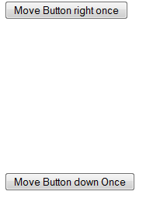
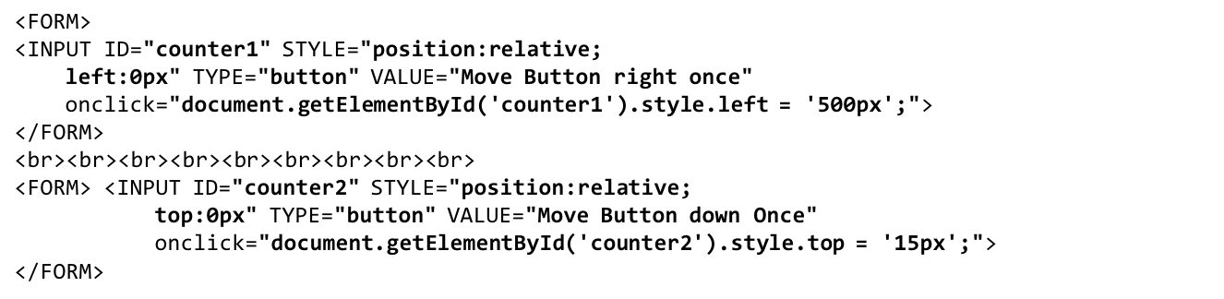
Example 4: document.getElementById().style.left
JavaScript and HTML w/o jQuery
http://cs-server.usc.edu:45678/examples/dom/ex4.html
Copyright Ellis Horowitz 2012-2016

Slide 15

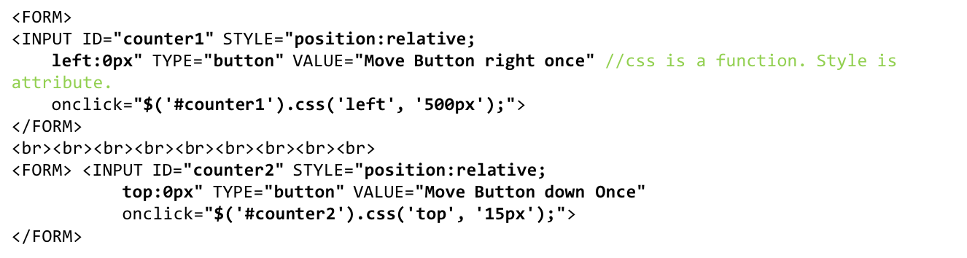
JavaScript and HTML w/ jQuery
http://cs-server.usc.edu:45678/examples/jquery/dom/ex4.html
Copyright Ellis Horowitz 2012-2016

Slide 16
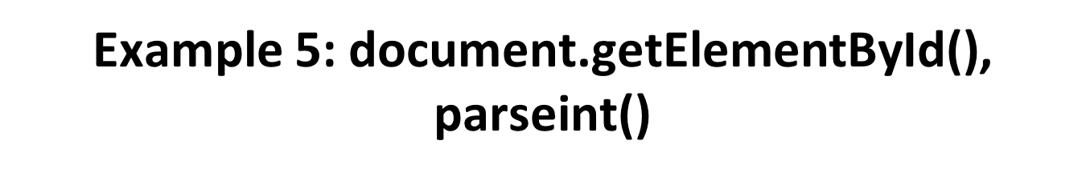

JavaScript w/o jQuery
var obj = document.getElementById(‘counter1’);
var xlocation = parseInt(obj.style.left);
function handleClick( ) {
xlocation += 50;
document.getElementById(‘counter1’).style.left = xlocation + “px”;}
JavaScript w/ jQuery
$(function() {
$(“#counter1”).css(“left”,(parseInt($(“#counter1”).css(“left”))+50)+”px”);
});
});
http://cs-server.usc.edu:45678/examples/dom/ex5.html
http://cs-server.usc.edu:45678/examples/jquery/dom/ex5.html
Copyright Ellis Horowitz 2012-2016

Slide 17
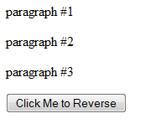
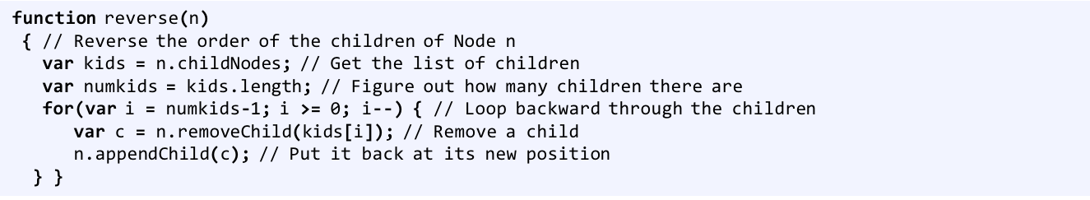
Example 6: Uses childNodes, removechild, appendChild
JavaScript w/o jQuery
http://cs-server.usc.edu:45678/examples/dom/ex6.html
Copyright Ellis Horowitz 2012-2016

Slide 18
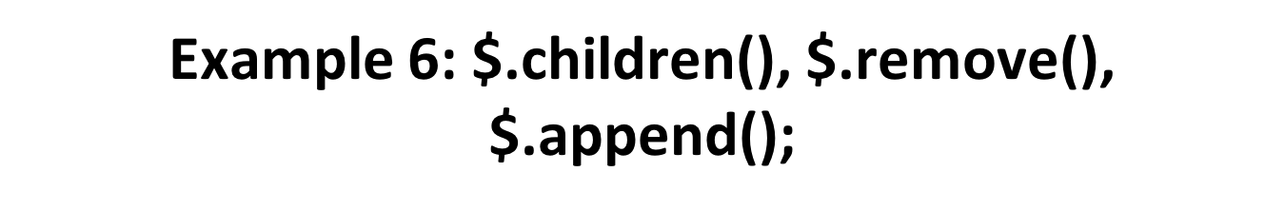
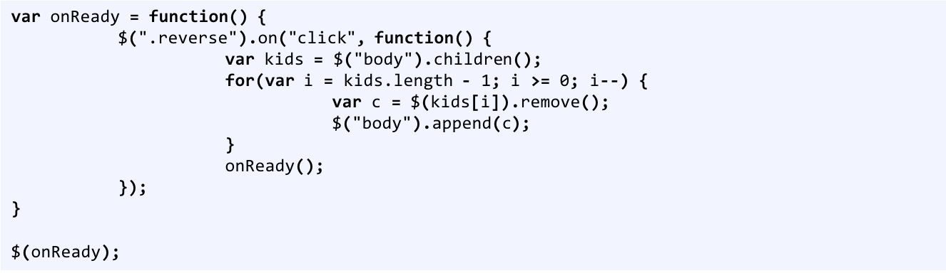
JavaScript w/ jQuery
http://cs-server.usc.edu:45678/examples/jquery/dom/ex6.html
Copyright Ellis Horowitz 2012-2016

Slide 19
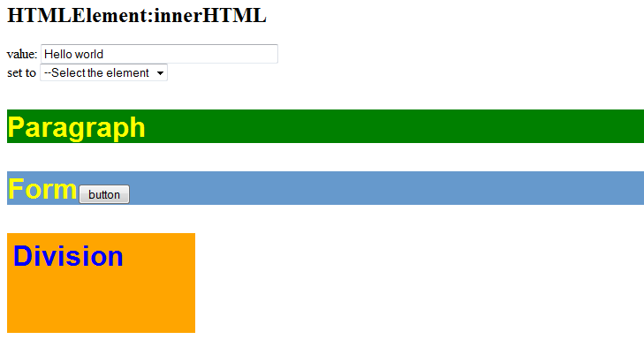
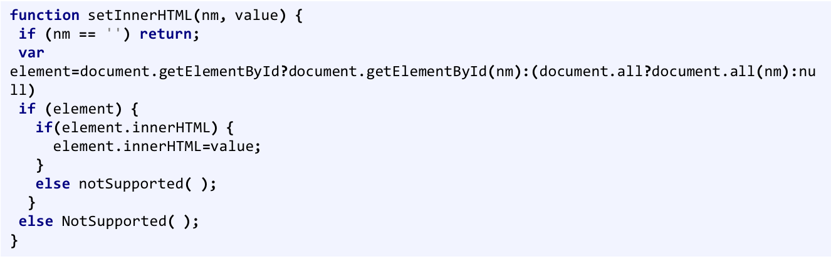
Example 7: Uses innerHTML
JavaScript w/o jQuery
http://cs-server.usc.edu:45678/examples/dom/domtest.html
Copyright Ellis Horowitz 2012-2016

Slide 20

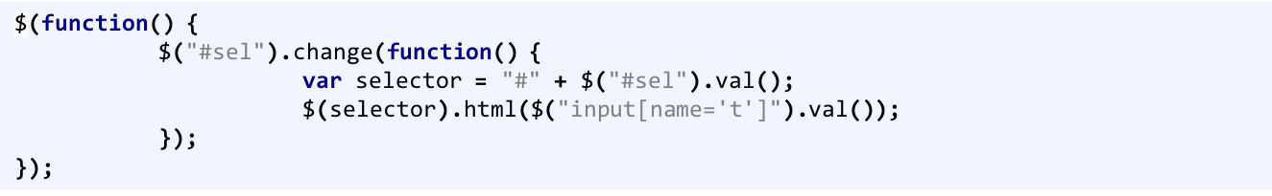
JavaScript w/ jQuery
http://cs-server.usc.edu:45678/examples/jquery/dom/domtest.html
Copyright Ellis Horowitz 2012-2016

Slide 21
jQuery & AJAX
jQuery has a series of functions which provide a common interface for AJAX, no matter what browser you are using.
Most of the upper level AJAX functions have a common layout:
  $.func Get/Post/Load(url[,params][,callback]), [ ] optional
    url: string representing server target
    params: names and values to send to server
    callback: function executed on successful communication.
Copyright Ellis Horowitz 2012-2016

Slide 22
jQuery AJAX load method
The load() method loads data from a server and puts the returned data into the selected element.
$(selector).load(URL,data,callback);
The selector is a usually a reference to div or span tag
The required URL parameter specifies the URL you wish to load.
The optional data parameter specifies a set of querystring key/value pairs to send along with the request.
The optional callback parameter is the name of a function to be executed after the load() method is completed.
For examples see
http://cs-server.usc.edu:45678/ajaxexamples/simple/simpleajaxexjquery.html
Copyright Ellis Horowitz 2012-2016

Slide 23
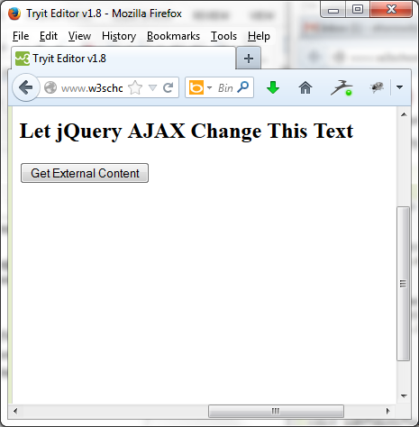
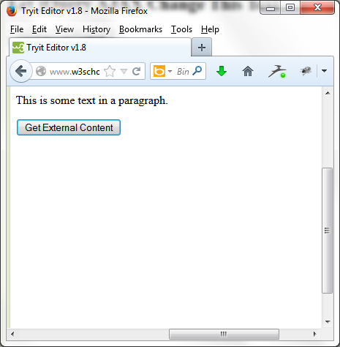
AJAX Example 1
<!DOCTYPE html><html><head>
<script src="http://ajax.googleapis.com/ajax/libs/jquery/1.10.2/jquery.min.js">
</script>
<script>
$(document).ready(function(){
$("button").click(function(){
$("#div1").load("demo_test.txt #p1");
});
});
</script>
</head><body>
<div id="div1"><h2>Let jQuery AJAX Change This Text</h2></div>
<button>Get External Content</button>
</body></html>
Copyright Ellis Horowitz 2012-2016

Slide 24
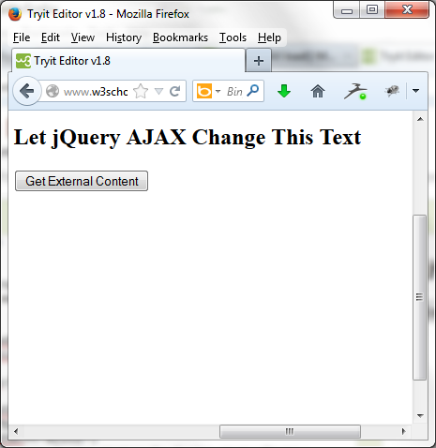
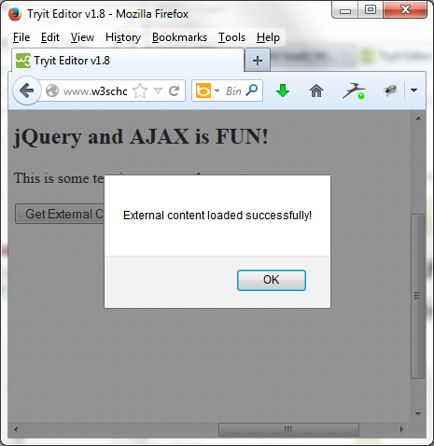
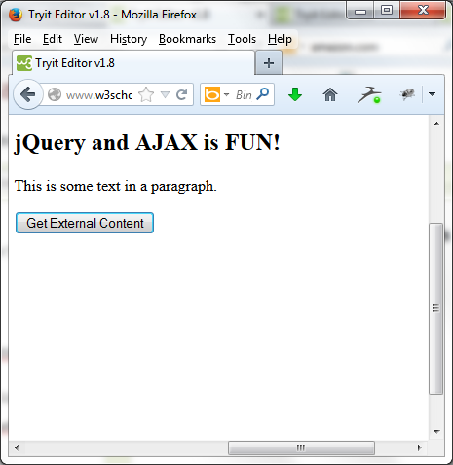
AJAX Example 2
<!DOCTYPE html><html><head>
<script src="http://ajax.googleapis.com/ajax/libs/jquery/1.10.2/jquery.min.js">
</script><script>
$(document).ready(function(){
$("button").click(function(){
$("#div1").load("demo_test.txt",function(responseTxt,statusTxt,xhr){
if(statusTxt=="success")
alert("External content loaded successfully!");
if(statusTxt=="error")
alert("Error: "+xhr.status+": "+xhr.statusText); }); }); });
</script></head><body>
<div id="div1"><h2>Let jQuery AJAX Change This Text</h2></div>
<button>Get External Content</button></body></html>
Copyright Ellis Horowitz 2012-2016

Slide 25
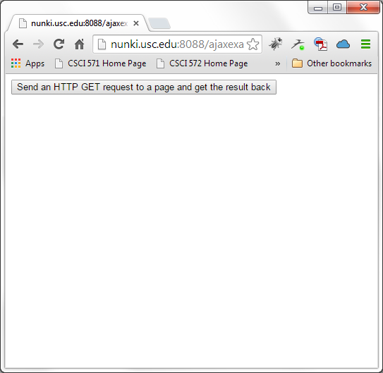
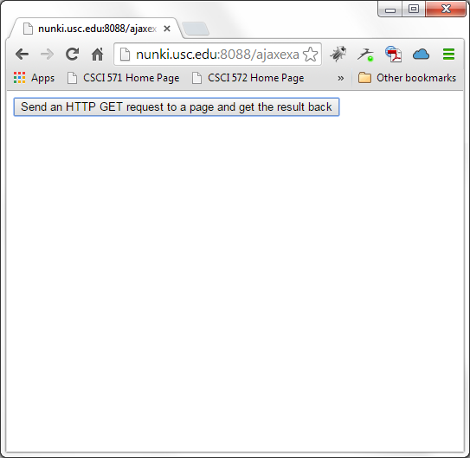
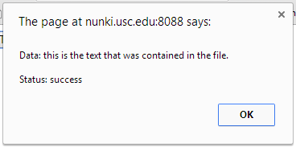
AJAX Example 3 – GET Method
<!DOCTYPE html><html><head>
<script src="http://ajax.googleapis.com/ajax/libs/jquery/1.10.2/jquery.min.js">
</script><script>
$(document).ready(function(){
$("button").click(function(){
$.get("demo_test3.test",function(data,status){
alert("Data: " + data + "\nStatus: " + status);
});
});
});
</script></head><body>
<button>Send an HTTP GET request to a page and get the result back</button>
</body></html>
The $.get() method requests data from the server
with an HTTP GET request.
The required URL parameter specifies the URL you wish to request.
The optional callback parameter is the name of a function to be executed if the request succeeds.
The following example uses the $.get() method to retrieve data from a file on the server
Copyright Ellis Horowitz 2012-2016

Slide 26
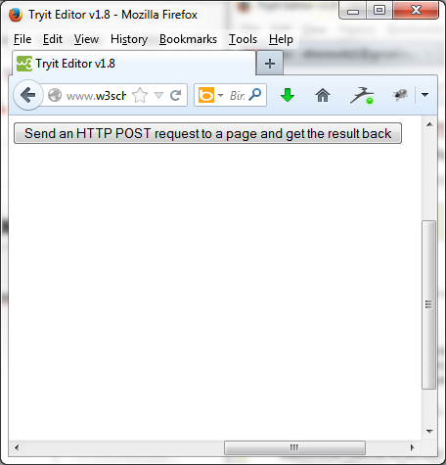
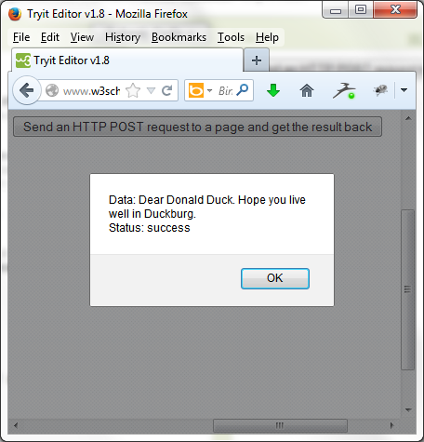
AJAX Example 4 – POST Method
<!DOCTYPE html><html><head>
<script src="http://ajax.googleapis.com/ajax/libs/jquery/1.10.2/jquery.min.js">
</script><script>
$(document).ready(function(){
$("button").click(function(){
$.post("demo_test_post.php",
{
name:"Donald Duck",
city:"Duckburg"
},
function(data,status){
alert("Data: " + data + "\nStatus: " + status);
});
});
});
</script></head><body>
<button>Send an HTTP POST request to a page and get the result back</button>
</body></html>
Copyright Ellis Horowitz 2012-2016

Slide 27
Summary jQuery AJAX Functions
$.func(url[,params][,callback])
  $.get
  $.getJSON
  $.getIfModified
  $.getScript
  $.post
$(selector), inject HTML
  load
  loadIfModified
$(selector), ajaxSetup alts
  ajaxComplete
  ajaxError
  ajaxSend
  ajaxStart
  ajaxStop
  ajaxSuccess
$.ajax, $.ajaxSetup
  async
  beforeSend
  complete
  contentType
  data
  dataType
  error
  global
  ifModified
  processData
  success
  timeout
  type
  url
Copyright Ellis Horowitz 2012-2016

Slide 28
jQuery Usage Example (1)
  jQuery way of a mouseover event that shows a submenu when menu is selected:
  $(‘#menu’).mouseover(function() { // Anonymous function
  $(‘#submenu’).show();
  });
Copyright Ellis Horowitz 2012-2016

Slide 29
jQuery Usage Example (2)
  Stopping a normal event action: Suppose we want to stop the action of following a URL when a link is clicked. The action is part of the event object. We can reference the event object and call .preventDefault();
      $(‘#menu’).click(function(evt){
      //JS code here
      evt.preventDefault();
      }
Copyright Ellis Horowitz 2012-2016

Slide 30
jQuery Usage Example (3)
Selecting all form elements of a certain type:
  $(‘:text’) It selects all text fields.
Use with :input ( all form elements), :password, :radio, :checkbox, :submit, :image, :reset, :button, :file, :hidden
Set the value of a form element
  Var fieldvalue = $(‘#total’).val(Yourvalue);
Copyright Ellis Horowitz 2012-2016

Slide 31
jQuery Usage Example (4)
Determining if checkbox is checked
  If ($(‘#total’).attr(‘checked’)) {
    //Do whatever you want if box is checked
    }
    else {
    //Do whatever you want if box is not checked
    }
Copyright Ellis Horowitz 2012-2016

Slide 32
jQuery Usage Example (5)
Form Events such as submit:
    $(document).ready(function() {
    $(‘#signup’).submit(function() {
    if ($(‘#username’).val() ==‘’) {
    alert (‘Please supply name to name field’);
    return false;
    }
    })
    });
Copyright Ellis Horowitz 2012-2016

Slide 33
jQuery Usage Example (6)
Focus Example: Auto erases default text in a field when it gets the focus
  <input name=“username” type=“text” id=“username” value=“Please type your user name”>
  $(‘#username’).focus(function() {
  var field = $(this);
  if(field.val()==field.attr(‘defaultValue’)) {
  field.val(‘’);
  }
  });
Copyright Ellis Horowitz 2012-2016

Slide 34
jQuery Usage Example (7)
Click: If any radio button is clicked
    $(‘:radio’).click(function() {
    //do stuff
    });
Add focus to the first element of the form:
  $(‘username’).focus;
Copyright Ellis Horowitz 2012-2016

Slide 35
jQuery Snippet that Detects Browser Width
<html><head><link rel="stylesheet" href="style.css" type="text/css" />
<script type="text/javascript" src="http://ajax.googleapis.com/ajax/libs/jquery/1.4.4/jquery.min.js">
</script></head><body>
<h2>Text that will be red if screen width is less than 800px, mobile.css is used,
and text will be green if screen width is greater than 800px, style.css is used, and black if no style sheet is specified</h2>
<div id="browserInfo" style="padding:8px; border:1px solid blue; width:300px;"></div>
<script type="text/javascript">
$(document).ready(function(){ resizeWindow();
$(window).bind('resize', resizeWindow);
getBrowserInfo(); });
function resizeWindow(){$('#browserInfo').text('Browser (Width : ' + $(window).width() +
' , Height :' + $(window).height() + ' )');
var newWindowWidth = $(window).width();
// If window width is below 800px, switch to the mobile stylesheet
if(newWindowWidth < 800){ $("link[rel=stylesheet]").attr({href : "mobile.css"}); }
// Else if width is above 800px, switch to the large stylesheet
else //if(newWindowWidth >= 800)
{ $("link[rel=stylesheet]").attr({href : "style.css"});
} }
function getBrowserInfo(){
$('#browserInfo').text('Browser (Width : ' + $(window).width() +
' , Height :' + $(window).height() + ' )'); }
</script><noscript></body></html>
Copyright Ellis Horowitz 2012-2016

Slide 36
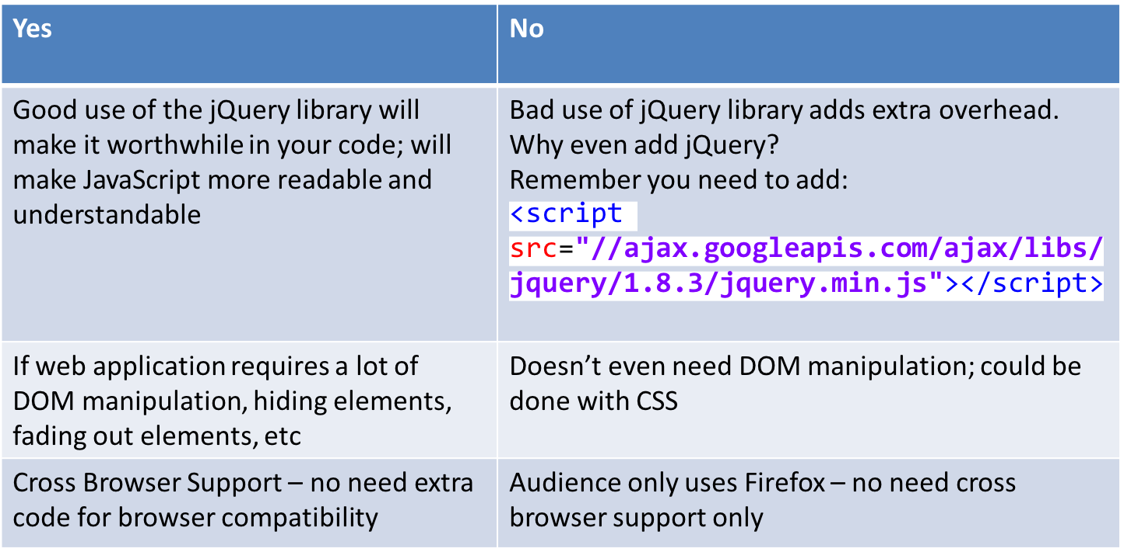
Is jQuery Worth It?
Copyright Ellis Horowitz 2012-2016

Slide 37
jQuery
It’s a useful library when used wisely.
It will allow you to write JavaScript differently
  Write less, do more.
Remember: jQuery is just JavaScript
  What you can do with jQuery, you can always do without jQuery but with more code.
Copyright Ellis Horowitz 2012-2016

Slide 38
jQuery Resources
Project website
  http://www.jquery.com
Learning Center
  http://docs.jquery.com/Tutorials
  http://www.learningjquery.com/
  http://15daysofjquery.com/
Support
  http://docs.jquery.com/Discussion
  http://www.nabble.com/JQuery-f15494.html mailing list archive
  irc.freenode.net irc room: #jquery
Documentation
  http://docs.jquery.com/Main_Page
  http://www.visualjquery.com
  http://jquery.bassistance.de/api-browser/
jQuery Success Stories
  http://docs.jquery.com/Sites_Using_jQuery
Copyright Ellis Horowitz 2012-2016

